Slide 1
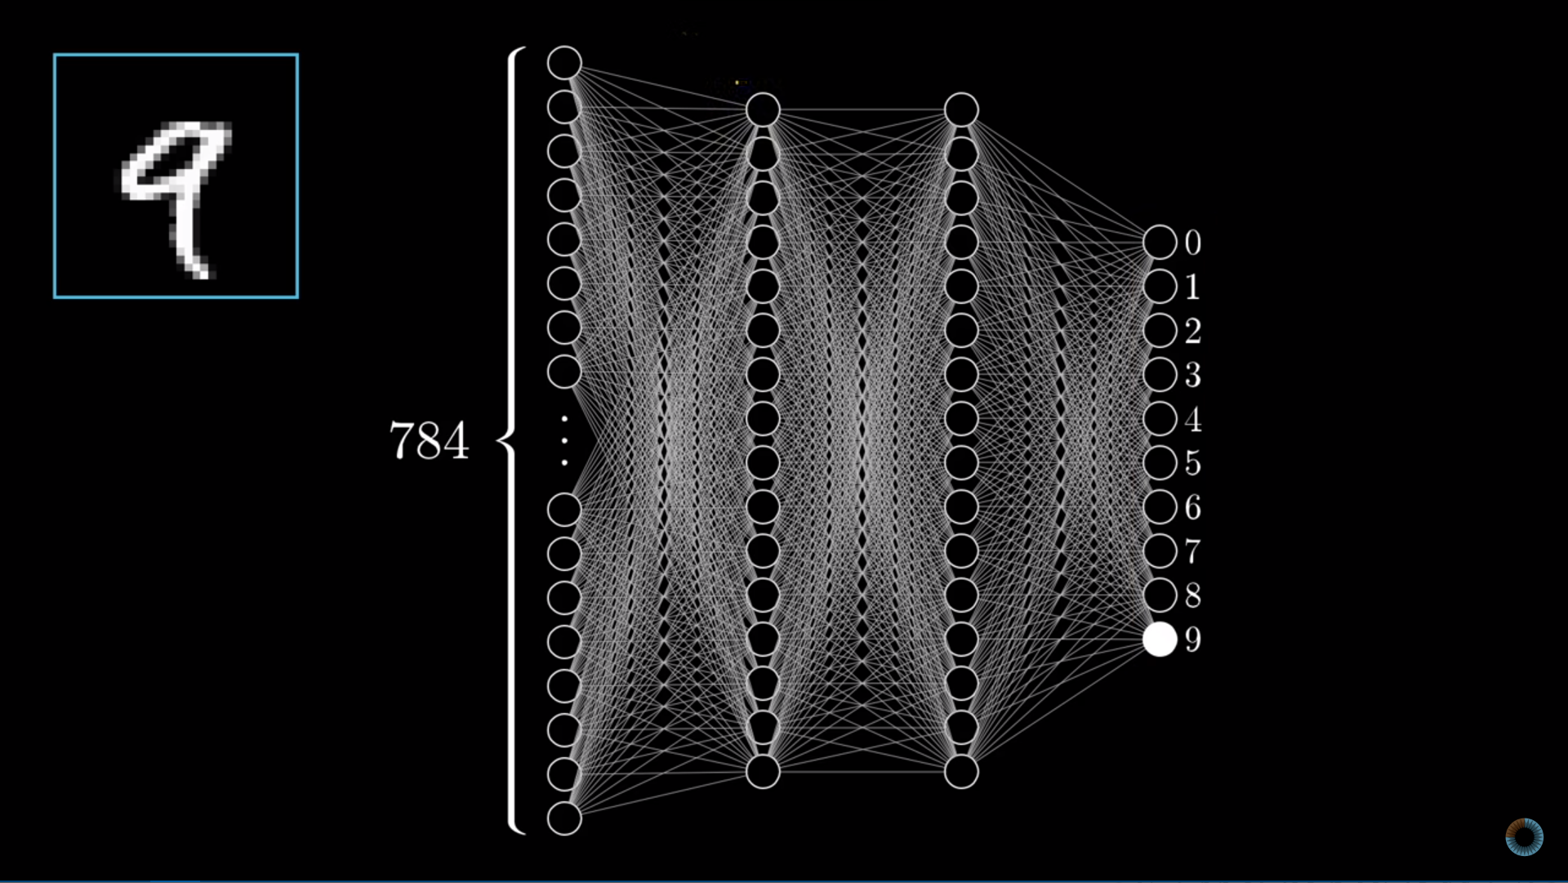
Credits : 3Blue1Brown on YouTube
Activations from one layer bring activations in the second layer up until the last layer that is our desired output.
But this does not happen right away. We first need to “Train” the network and by which I mean we need to set up the weights and biases that cause the correct activations in the next layer and so on till the output layer.

Slide 2
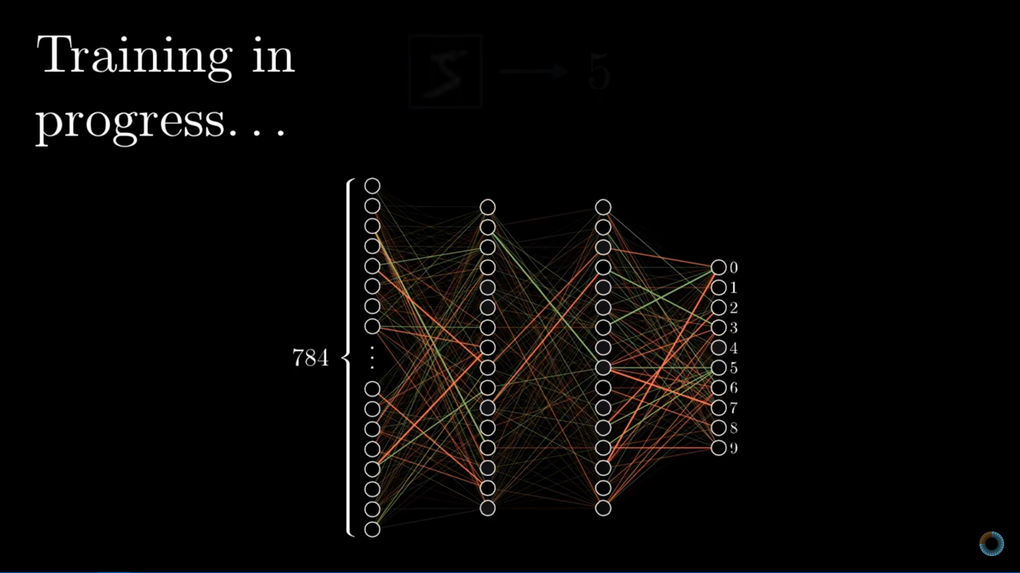
Credits : 3Blue1Brown on YouTube
So what happens in training? In the beginning, we set all the weights randomly and see how it performs on a labeled (whose answer is known) example. Once the network generates whatever outcome, we analyze it and since we have the answer to what it should look like, we tell the network what to look for.
Mathematically, we say we define a cost function. Cost function means that the more further away we are from the correct answer, the greater the cost will be for that one test. The goal is to use algorithms to minimize cost ultimately improving accuracy.

